Slide 1
Picking the Best Office
Abhinav Dulur January 1st, 2019

Slide 2
Business Problem
A recent graduate is offered a job by Google, but he/she must pick between various Google Office Branches. I will use my own personal experience as well as supervised machine learning to develop a decision tree to help people select which location they are suited for.
Target Audience
Recent graduates and anyone that is offered a job by Google.

Slide 3
Objective:
Use machine learning to help newly employed Googlers pick the best office location.

Slide 4
Data
Foursquare location data will be used, as well as online data sets that contain data about all cities such as crime rate, cost of living, and average salary. Online data will be captured manually, and Foursquare location data will be captured using the Foursquare API.
From the Foursquare API, I will limit my search to 100 locations and 500 meters around all buildings, which is a very walkable distance. This data should be relatively clean and does not require too much data processing.

Slide 5
Methodology
I used a supervised machine learning technique, Decision Trees, to build my classifier. I am assuming that recent graduates will have similar tastes to myself (as I am also a recent graduate), which is why they will be able to use my Decision Tree.
A Decision Tree Classifier was used due to its simplicity and ease of use when explaining to individuals not familiar with machine learning or data science.

Slide 6
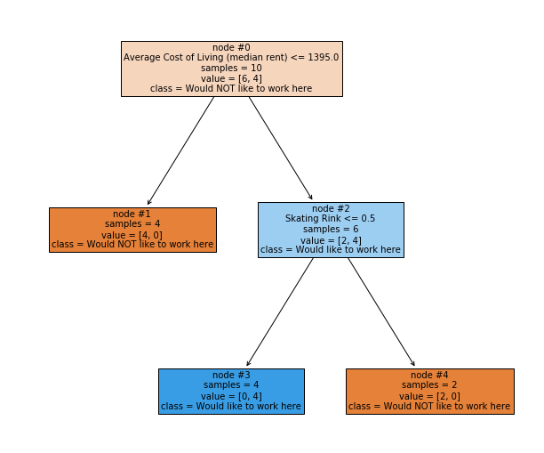
Results
True
False
True
False

Slide 7
Discussion
If someone my age and is a recent graduate is deciding between various Google office locations, then I would recommend them to look at the median rent as well as the presence of a Skating Rink.
Possible explanations for the tree:
I prefer high-rent areas due to the increased safety and quality of goods and services.
I do not prefer Skating Rinks due to the crowd they typically attract (Skating Rinks are known to attract families and older individuals).

Slide 8
Conclusion
In conclusion I have used personal experience, Foursquare location data, online sources, and supervised machine learning to create a Decision Tree Classifier to help recent graduates select a Google location to work for.
This classifier has concluded that to find the best location, one must look at the median rent and the presence of a Skating Rink.
Future Work
to make the classifier more robust, I should visit more Google office locations, as well as add additional online data from various other online sources / API's.

